Slide 1

A gamified introduction to Python Programming Lecture 1 Introduction
Matthieu DE MARI – Singapore University of Technology and Design

Slide 2

Outline (Chapter 1)
What are the objectives of this course?
What is programming?
What are the key concepts about programming and computer science?
What is a programming language?
How do I install and configure Python?
How to I write my first programs in Python?
What is a programming environment?
And many other things on the way!

Slide 3

Objectives of this course
Objectives:
Give the students an introduction to Computer Science, Programming, and Python.
Serves as a Computer Science 101 course.
Delivery:
Lessons include a bit of theory (PPT/PDF slides)
Autonomous practice activities (in Jupyter Notebooks).
Supporting videos online.

Slide 4

About Gamification
“Games are a good way of thinking about real problems. I use games in all my courses […] because things you have played with are things you remember.” - Jarrett Walker (Example of Gamification – Using the MiniMetro game to explain concepts of urban planning: http://humantransit.org/2014/12/learning-how-transit-works-from-mini-metro.html)

Slide 5
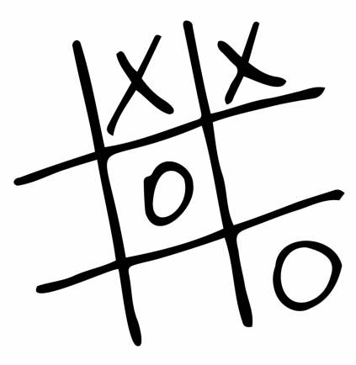
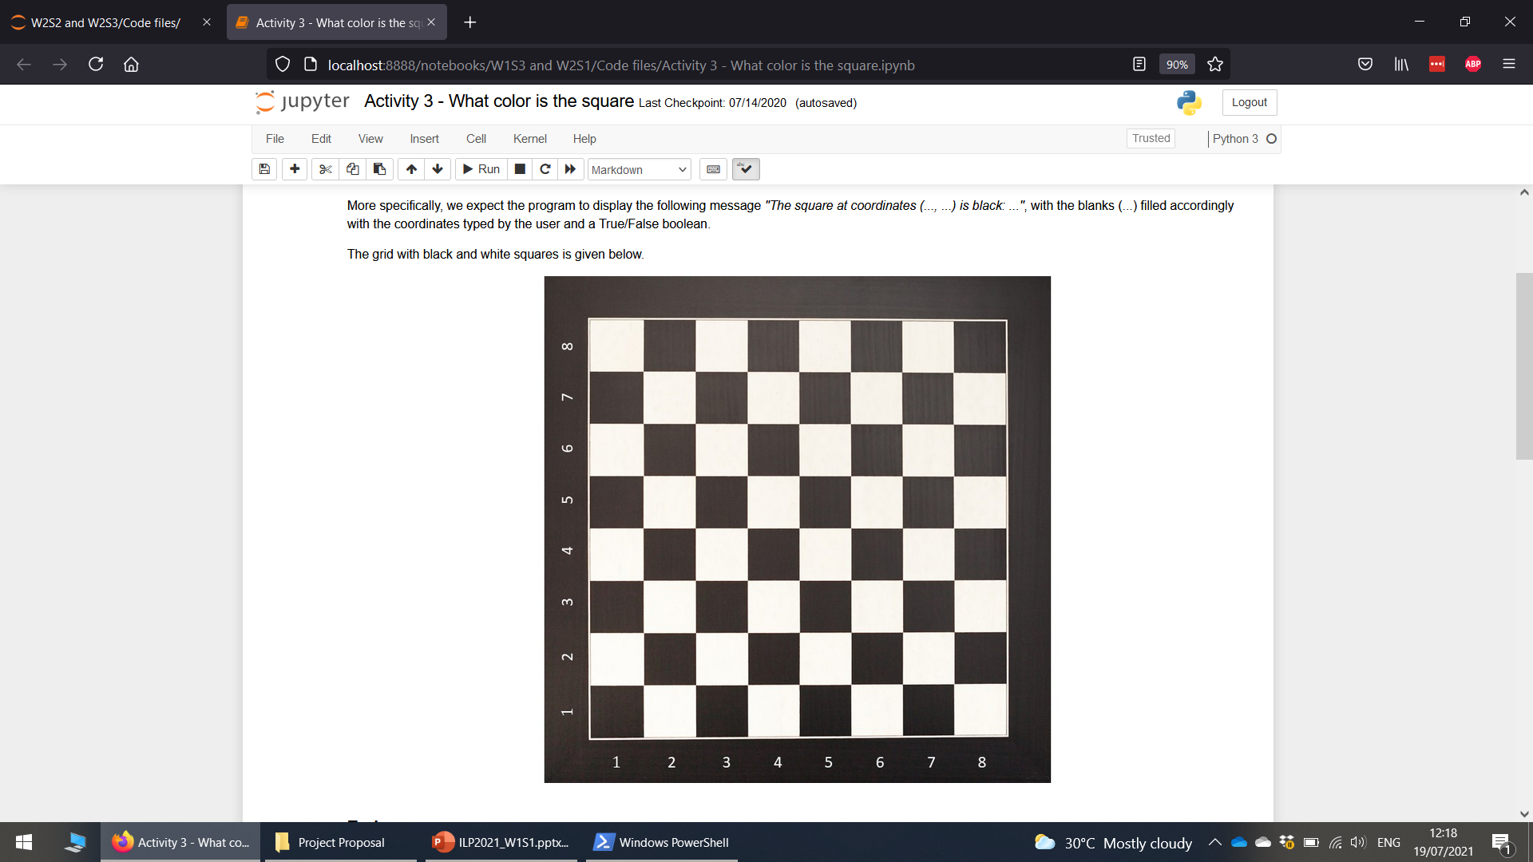
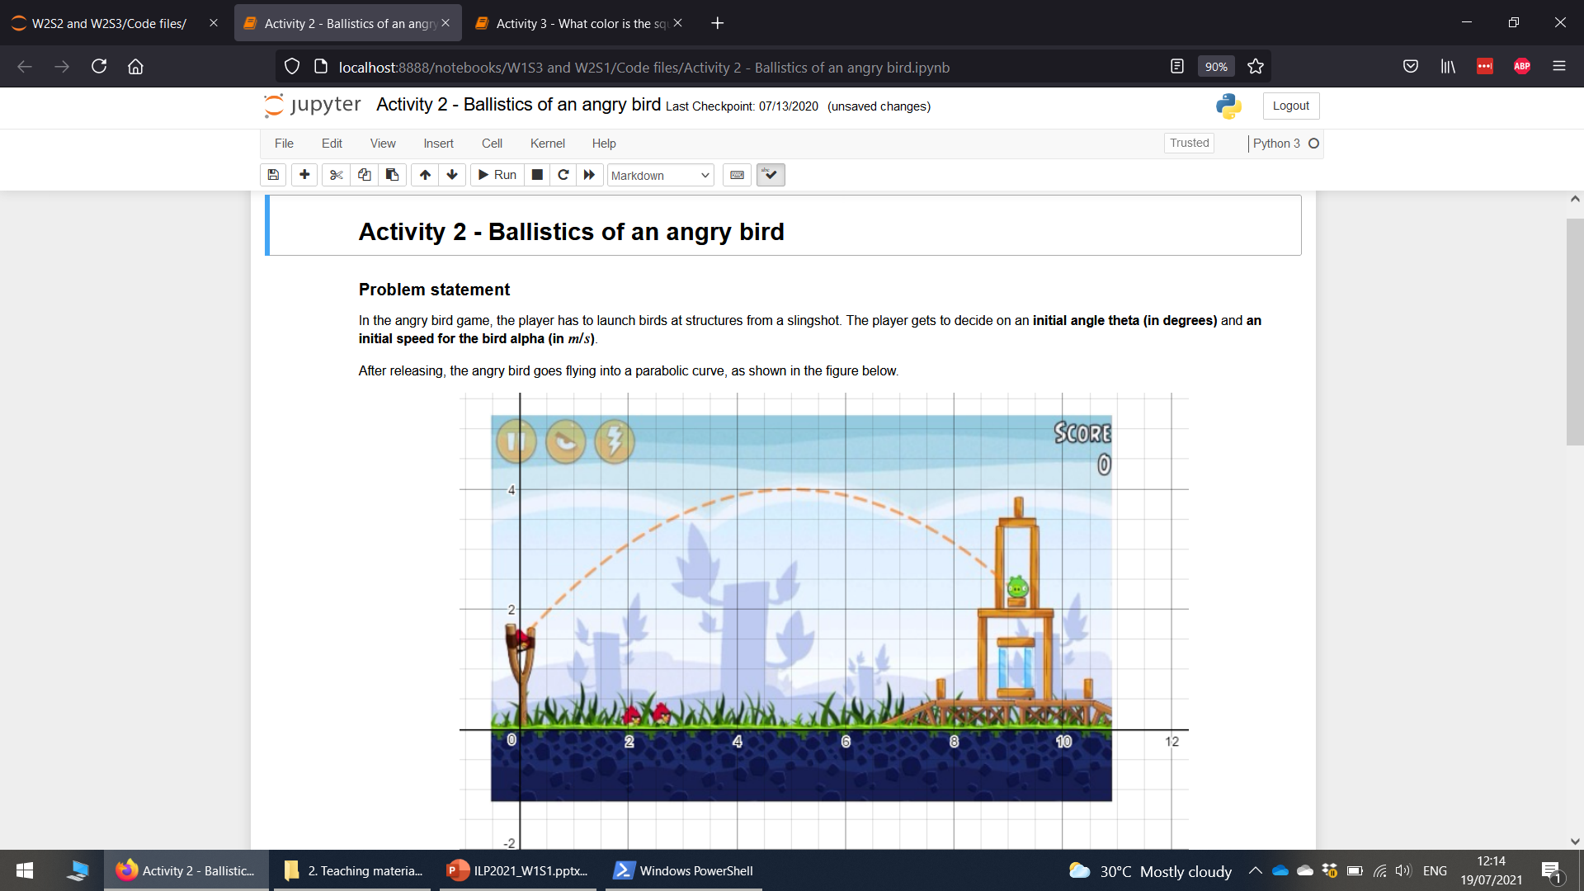
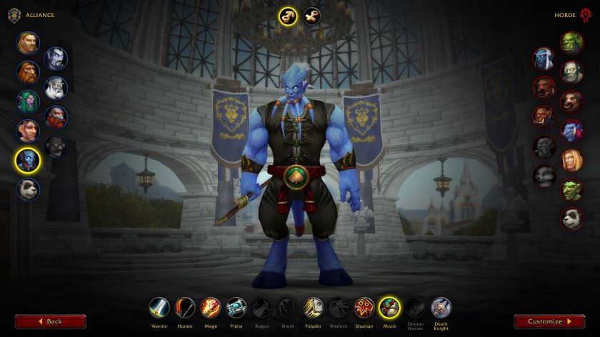
About Gamification

Slide 6



Please download and install the Slido app on all computers you use
What is programming anyway? Use your own words!
ⓘ Start presenting to display the poll results on this slide.

Slide 7
Some key definitions
Definition (Programming): Programming refers to the process of designing and building an executable computer program, to accomplish specific computational tasks.
Layman definition (Programming): Programming consists of defining a sequence of instructions (or algorithm), given by a human and that the computer must follow to accomplish a certain task.
Definition (Algorithm): An algorithm is a finite sequence of instructions, typically used to perform a computation task. When executed, on a provided set of inputs, it will proceed through a set of well-defined states and will eventually produce an output.

Slide 8


Programming and algorithms
Think of an algorithm as the sequence of instructions in a food recipe book!
Inputs would be the raw ingredients you are using. Outputs would be the dish produced as a result.
Instructions need to be clear and precise. (No vague “Put in the oven” instruction without a clear temperature and exact duration being specified!)
Instructions are followed sequentially. (No baking before mixing ingredients!)

Slide 9
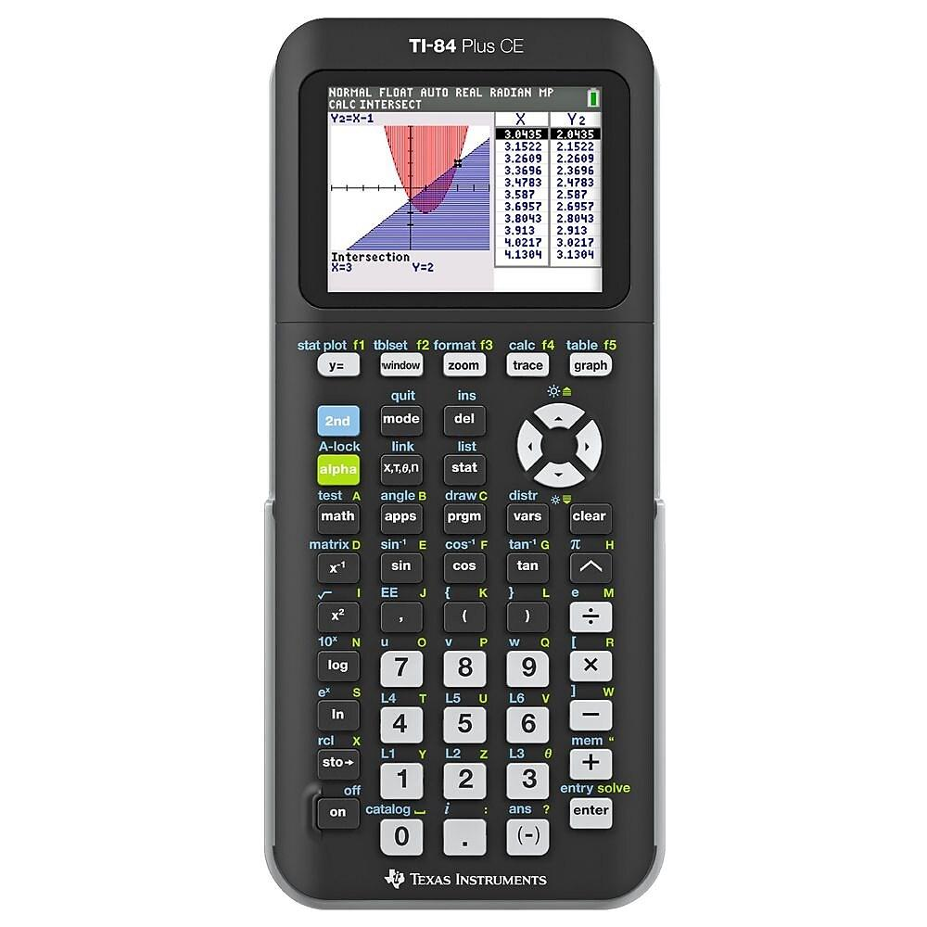
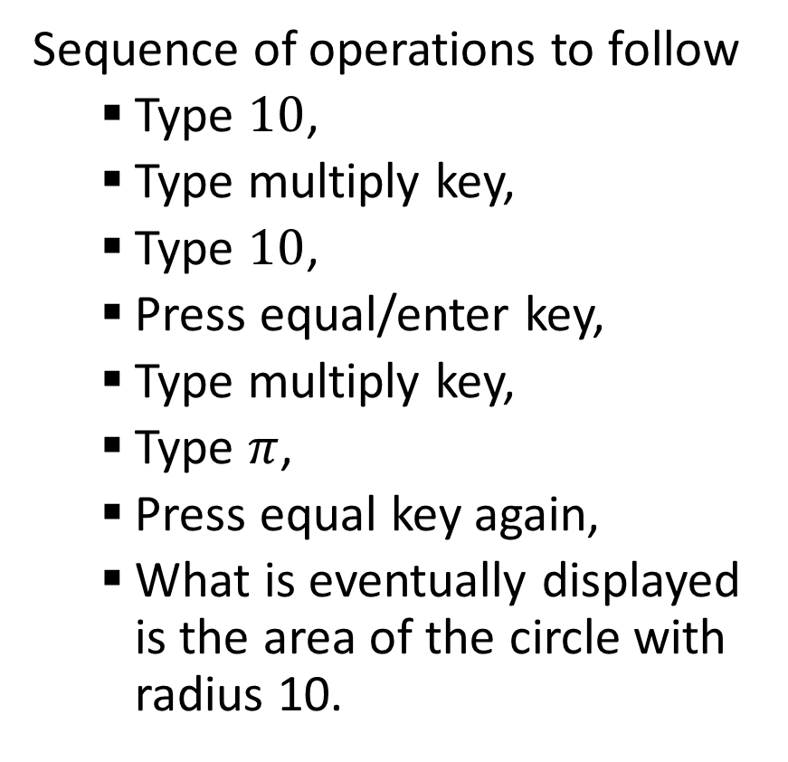
Programming and algorithms
Let us consider this example problem: Instructions to compute the area of a circle with radius 10.
Sequence of operations to follow
Type $10$,
Type multiply key,
Type $10$,
Press equal/enter key,
Type multiply key,
Type $π$,
Press equal key again,
What is eventually displayed is the area of the circle with radius 10.

Slide 10
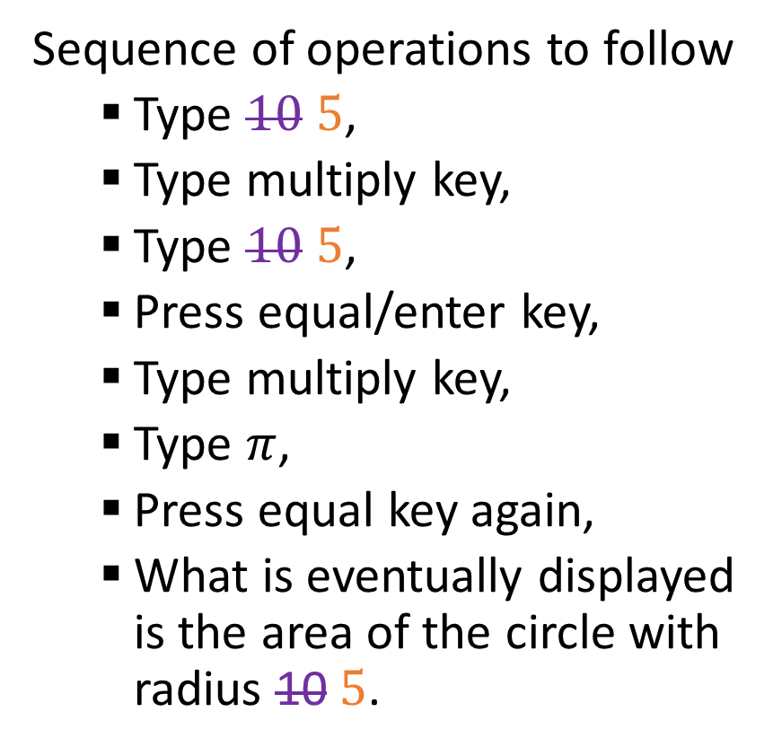
Programming and algorithms
Let us consider this example problem: Instructions to compute the area of a circle with radius 10.
Note: Here, the value 10 is an input for the algorithm. We could replace occurrences of the value 10 with another value, e.g. 5, and the algorithm would still produce the expected result as an output!
Sequence of operations to follow
Type $10$ $5$,
Type multiply key,
Type $10$ $5$,
Press equal/enter key,
Type multiply key,
Type $π$,
Press equal key again,
What is eventually displayed is the area of the circle with radius 10$5$.

Slide 11
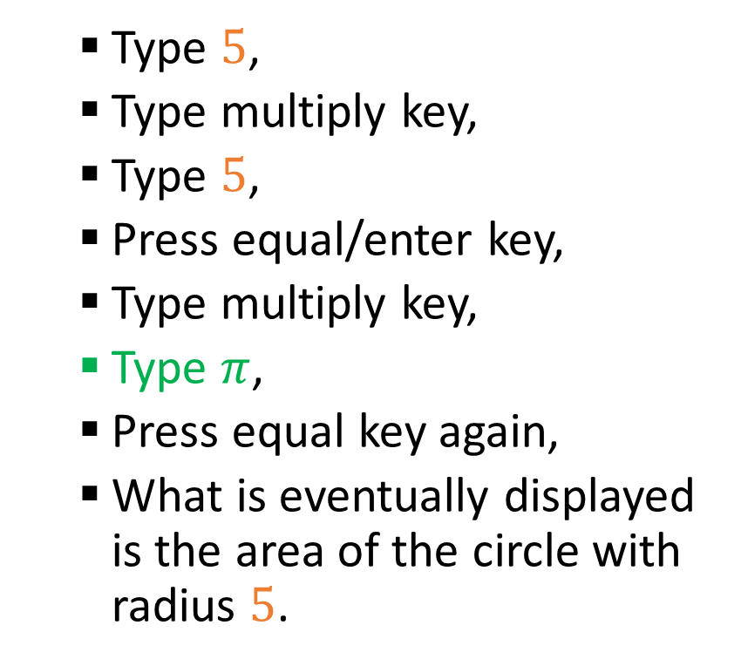
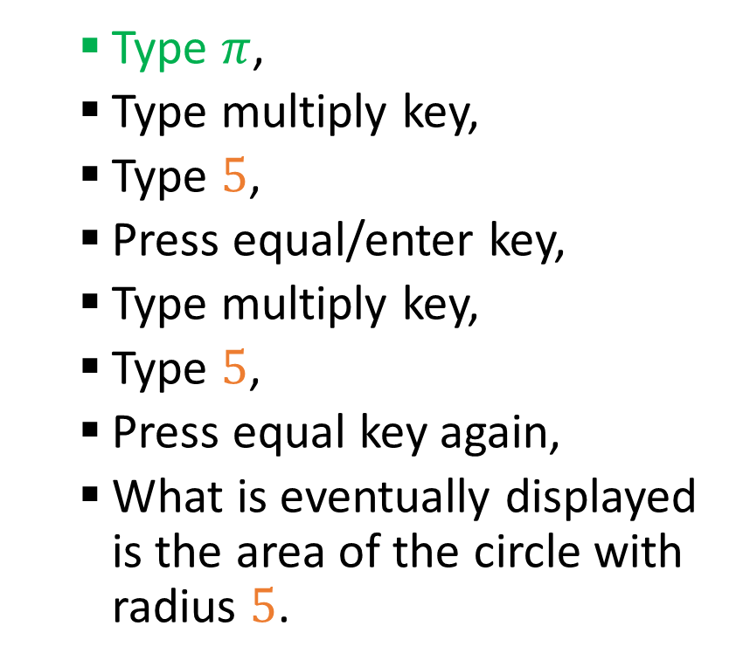
Programming and algorithms
Note: Multiple algorithms could work for the same problem!
Type $π$,
Type multiply key,
Type $5$,
Press equal/enter key,
Type multiply key,
Type $5$,
Press equal key again,
What is eventually displayed is the area of the circle with radius $5$.
Type $5$,
Type multiply key,
Type $5$,
Press equal/enter key,
Type multiply key,
Type $π$,
Press equal key again,
What is eventually displayed is the area of the circle with radius $5$.

Slide 12
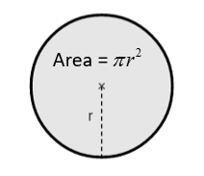
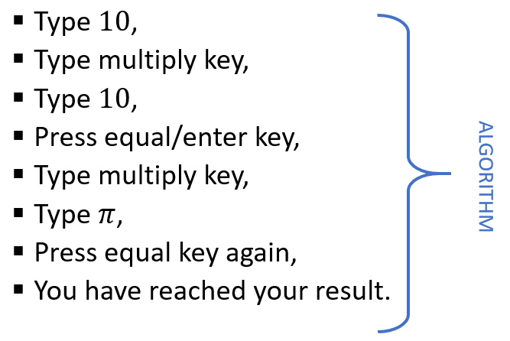


The life of a programmer
Problem Analysis: Identify a problem and understand its components.
Algorithm Design: Come up with an algorithm to solve said problem.
Step-by-step instructions,
To be followed sequentially,
With some expected inputs and outputs
Coding: Explain this algorithm to the computer, using a programming language.
Testing: Execute the program on a computer and see if it produces the expected results!

Slide 13
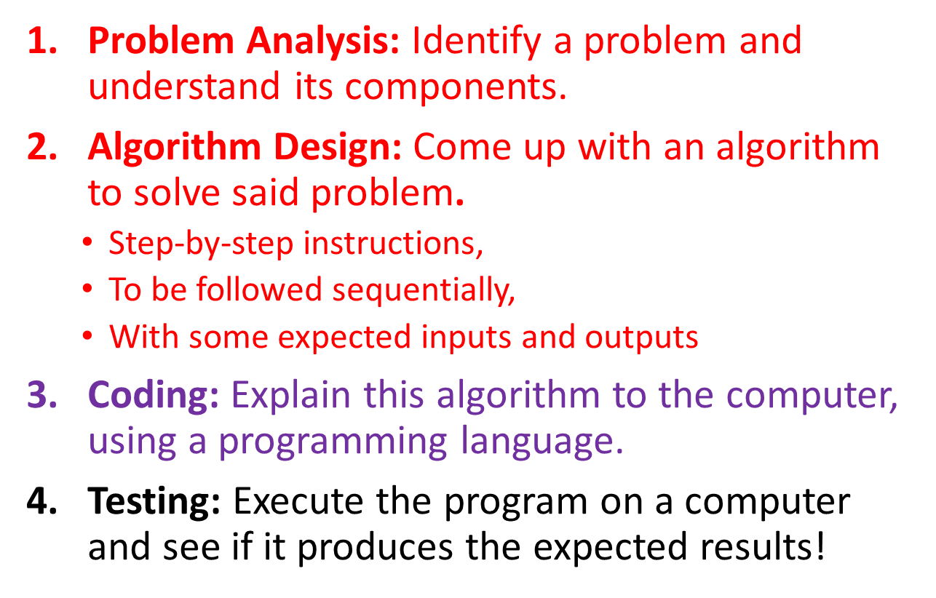
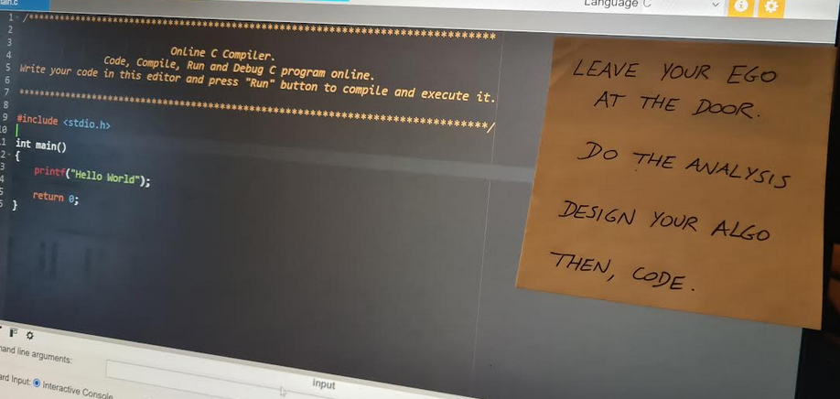
A typical mistake
Typical mistake: Beginners will often skip these first two steps and jump straight into coding… That is not the right way to go!
Looking at your screen, trying to guess what to code? You probably need more time on the first two steps.
After all, coding is simply explaining your logic/algorithm to the computer for execution later. Figuring out the right logic/algorithm is your human job!

Slide 14

A contract between CS students and teachers
Commandment #1: Learning Programming is Like Learning the Piano
I understand that programming, like playing the piano, requires practice, patience, and perseverance.
While theory is important, I must also actively “play the piano”, that is, practice coding. Only I can play the piano and learn by doing so.
At first, it will be frustrating. My code may “sound bad” and fail in ways I do not yet understand, but I eventually will understand.
And if I persist, putting in consistent effort, coding will gradually become more intuitive until it feels like second nature.

Slide 15
A contract between CS students and teachers
Commandment #2: I am teaching YOU, not ChatGPT!
I commit to practicing coding myself rather than relying on tools like ChatGPT or other AIs to code in my place.
While these tools can be great at providing guidance, I recognize that they can also solve all the beginner activities for me, without me doing any actual work.
I understand that I cannot improve without doing the actual “piano playing”, or work, myself; and will therefore not over-rely on ChatGPT.

Slide 16
A contract between CS students and teachers
Commandment #3: Coding Can Be Frustrating — And That is Okay
I accept that frustration is a natural part of the learning process.
I will not let frustration deter me or faze me; instead, I will use it as a signal that I am challenging myself to learn something new.
When faced with challenges, I will take a step back, analyze the problem, and persist with a positive mindset.
I will see errors and bugs not as failures, but as opportunities to learn and indications on how to improve my code.
I understand that debugging is an essential skill and an integral part of the programming process.

Slide 17
A contract between CS students and teachers
Commandment #4: Problem-Solving Starts on Paper
I understand that before writing code, a programmer’s job is to think through the problem.
If I cannot explain, on paper, the logical steps to solve the problem, I will not be able to translate it into code.
In any scenario where I end up looking blankly at my screen not knowing where to start my coding, I will simply close my laptop and think about the activity using pen and paper first.
I will then embrace the use of pen and paper to organize my thoughts, draft plans, and clarify my approach.
I will not try to randomly guess the correct code to use by trying things out, hoping they will work out great.

Slide 18
A contract between CS students and teachers
Commandment #5: We all have the same Learning Curve
While I might ask friends for help, I will not blindly copy the code of my friends or compare my coding to theirs.
Other students in the classroom might feel coding is easy, because the logic of coding feels natural to them and/or they have already done programming before.
I might feel that coding is difficult and might find it frustrating that the other students do not struggle as much as I do.
That is okay, we all have the same learning curve in the end, but not necessarily the same pace or the same starting point.

Slide 19
A contract between CS students and teachers
By signing this (clearly NOT legally binding) contract, I commit to taking an active role in my programming education, embracing challenges as opportunities to grow, and practicing regularly and fairly.
Date: _________________________
Signed, _________________________ (Student Name)

Slide 20
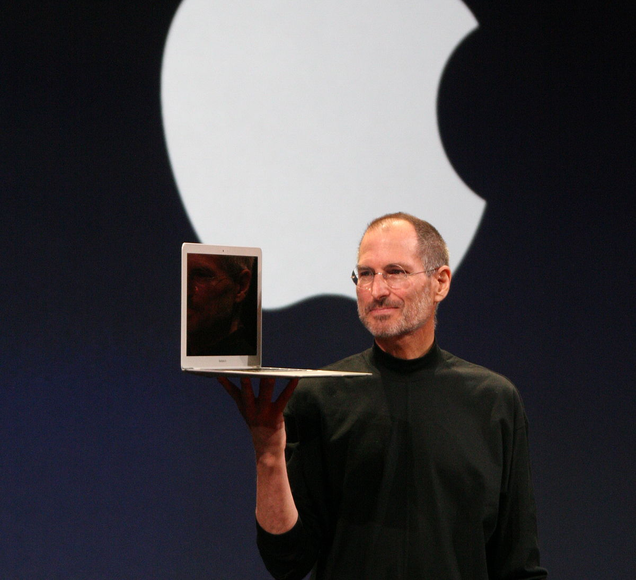
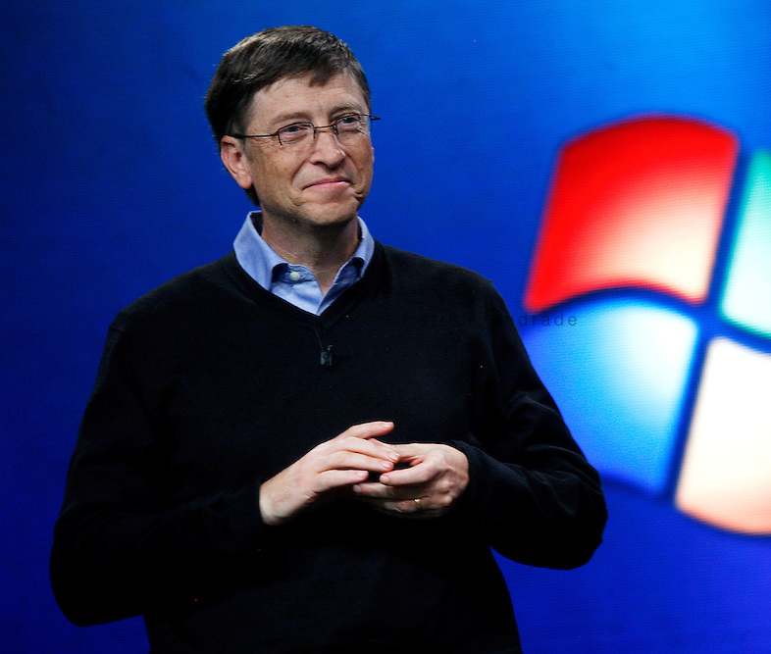
Quick question…
Who is considered the inventor of computers and programming?
Hint: It is probably NOT one of these two famous persons.
(They created Windows and MacOS, which are Operating Systems a.k.a. OS, not computers)

Slide 21
Please download and install the Slido app on all computers you use
Who is considered the inventor of computers and programming?
ⓘ Start presenting to display the poll results on this slide.

Slide 22
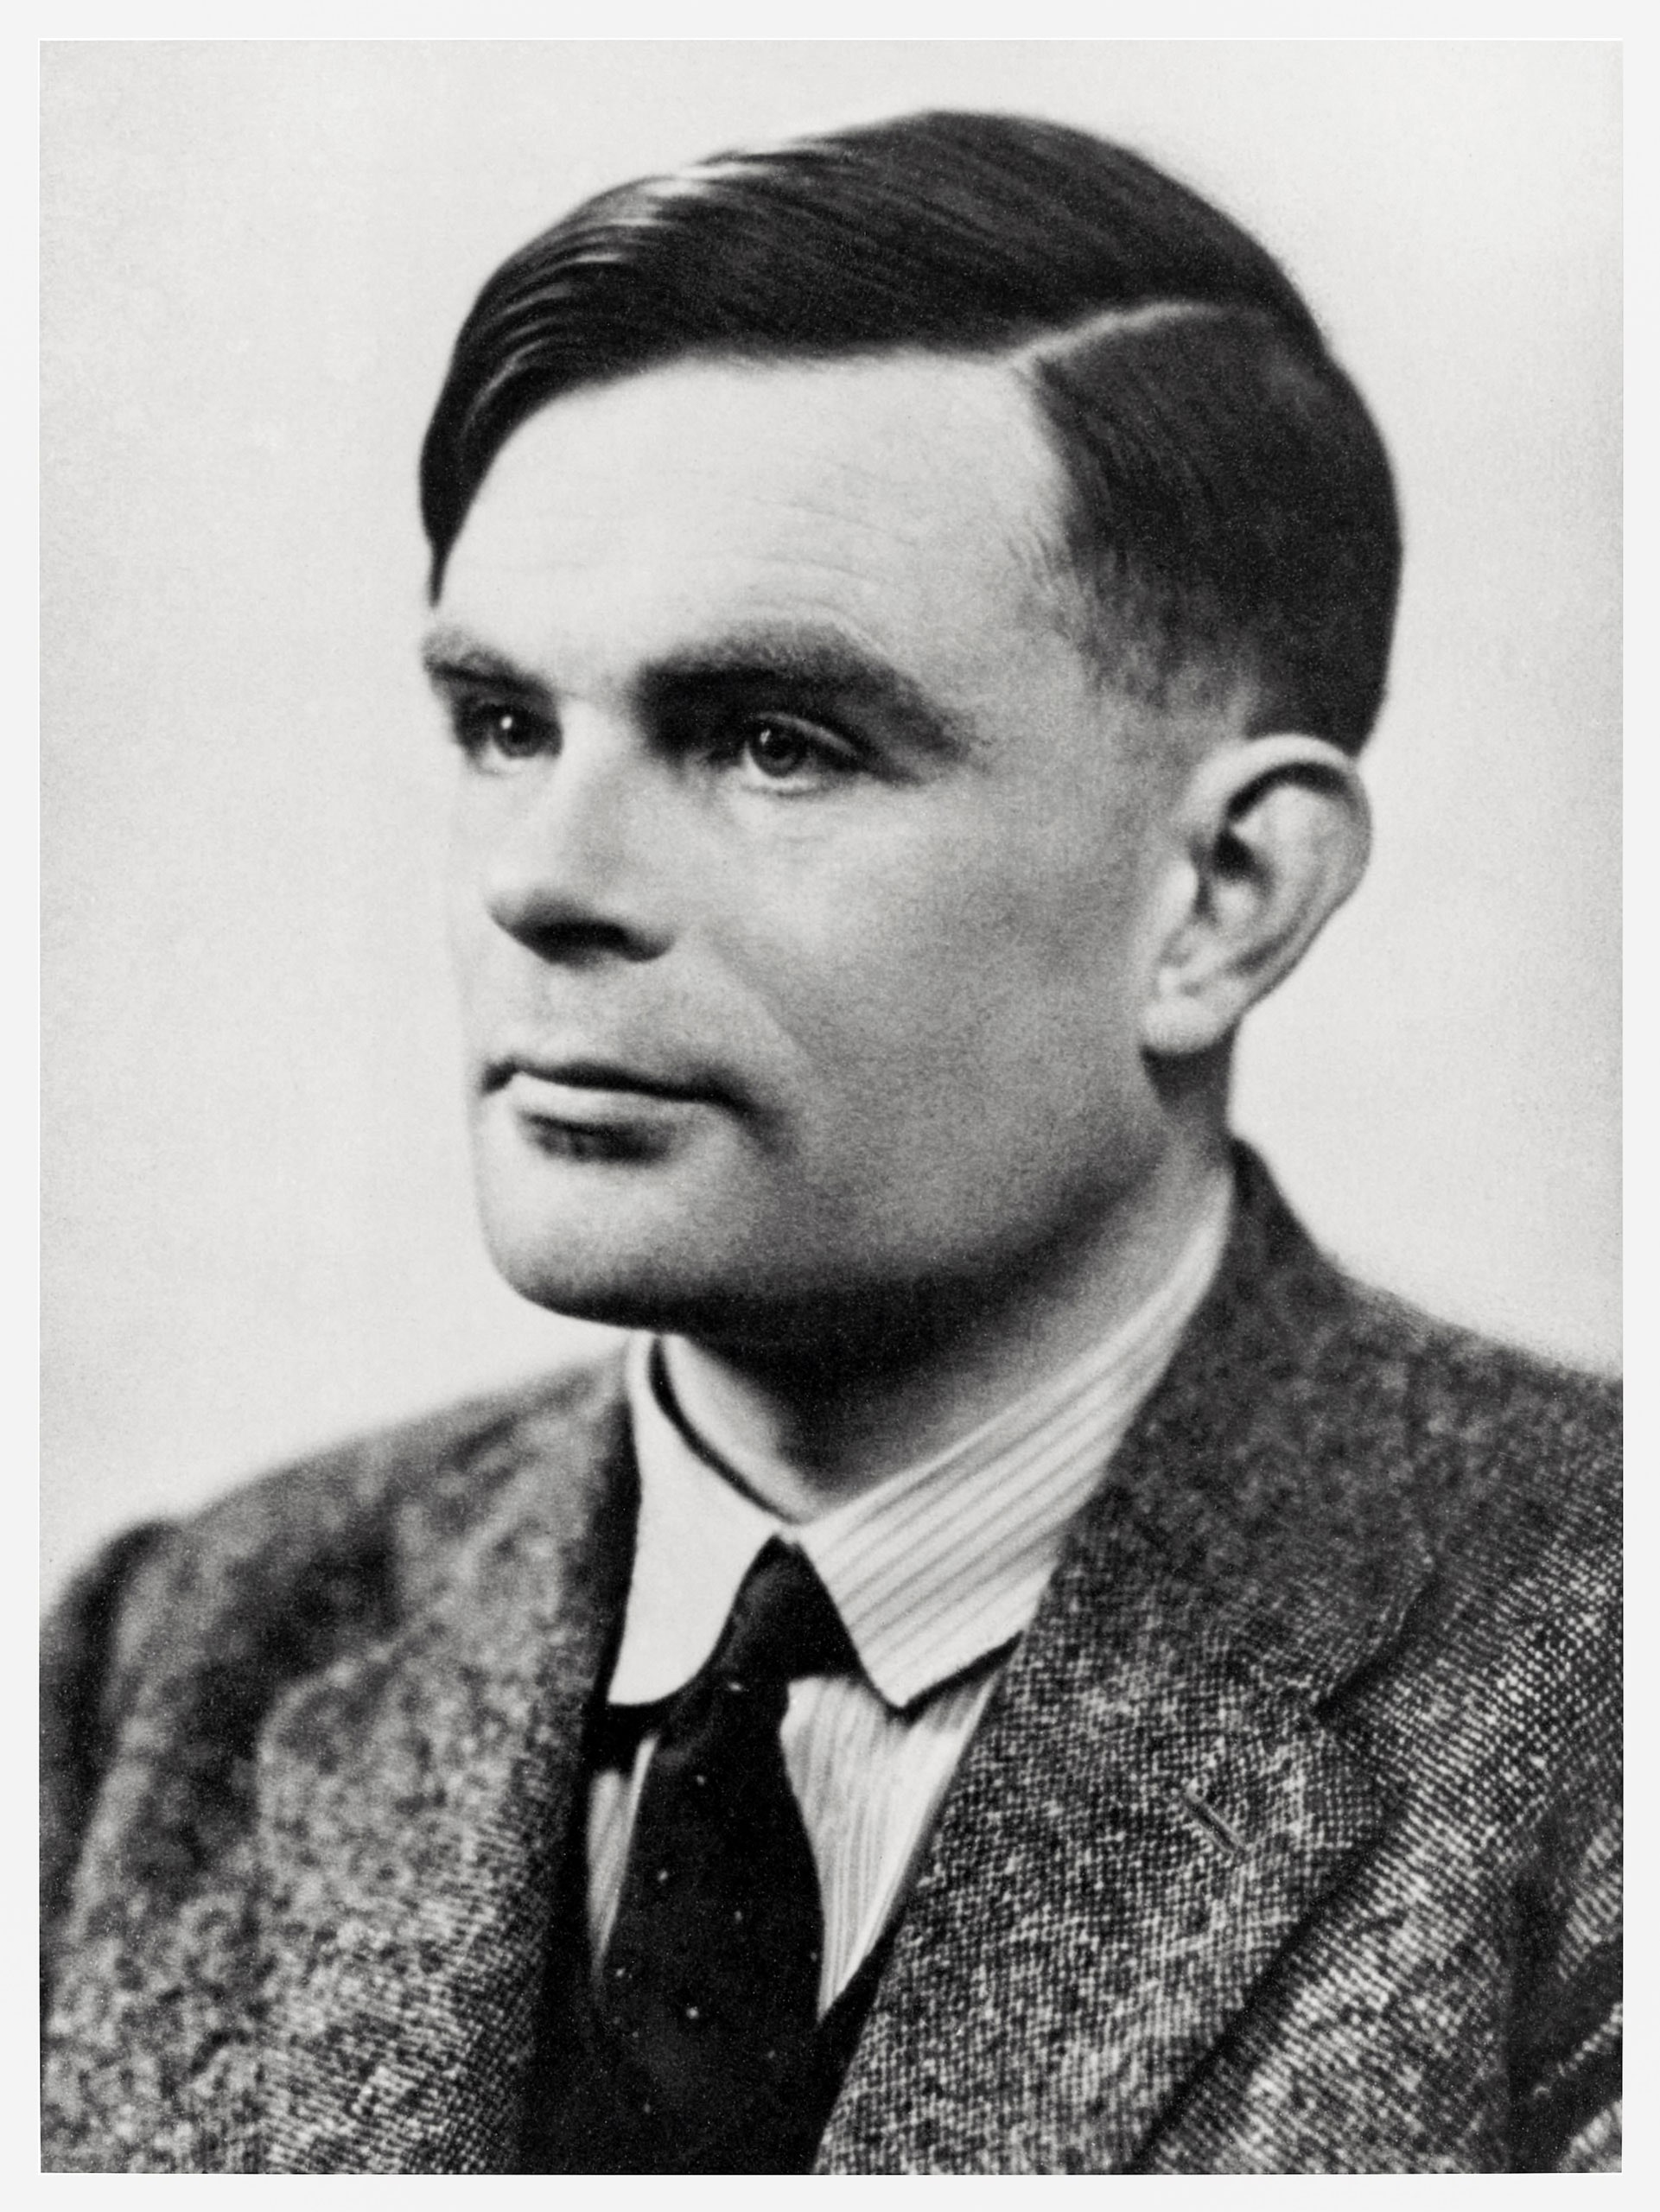
The “father” of computer science
Alan Mathison Turing (1912–1954) was an English mathematician, computer scientist, logician, cryptanalyst, philosopher, and theoretical biologist.
Highly influential in the development of theoretical computer science and formalized algorithmic concepts.
Created the first Turing machine, which can be considered the first general-purpose computer.

Slide 23

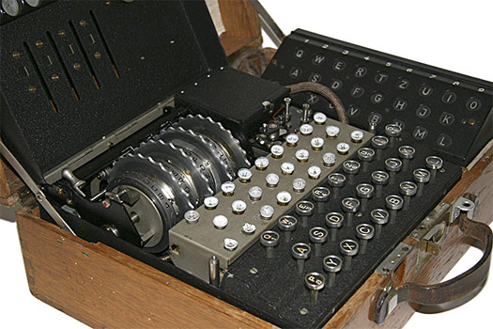
The “father” of computer science
During World War 2, he designed a “computer-like” machine, to decode encrypted transmissions coming from the German army (a.k.a. Enigma).
Thanks to his decryption device, it has been estimated that the war in Europe was shortened by more than two years, saving over 14 million lives.
Learn more about Alan Turing, by watching The Imitation Game movie. (Your first homework?)

Slide 24

About your computer
Your computer is good at doing two, and only two, things (nothing more!)
Perform computational tasks (calculations), as described by an algorithm.
Remember the results of these computational tasks, by storing them in its internal memory (and eventually retrieving these results, by accessing its memory).
And that is it. And that is all you need.
Because all operations performed by computers can be broken down into combinations of both.

Slide 25
The Von Neumann architecture
Central Processing Unit
Memory Unit
Output devices
Input devices
Definition (the Von Neumann architecture of a computer):
The Von Neumann architecture describes one of the first architectures for a computer.
It consists of several elements that every computer possesses, and each serves a specific purpose.
Control Unit
Arithmetic/Logic Unit

Slide 26
The Von Neumann architecture
Central Processing Unit
Memory Unit
Output devices
Input devices
It first consists of a Central Processing Unit (CPU), which itself consists of…
An Arithmetic/Logic Unit (in charge of dealing with instructions, typically math operations, in binary 0/1),
And a Control Unit (in charge of the hardware and communication between different hardware elements)
Control Unit
Arithmetic/Logic Unit

Slide 27
The Von Neumann architecture
Central Processing Unit
Memory Unit
Output devices
Input devices
It also contains…
A Memory Unit (for storing and retrieving results from previous computational tasks, using binary formatting 0/1),
Control Unit
Arithmetic/Logic Unit

Slide 28
The Von Neumann architecture
Central Processing Unit
Memory Unit
Output devices
Input devices
It also contains…
A Memory Unit (for storing and retrieving results from previous computational tasks, using binary formatting 0/1),
Inputs and Outputs Devices (e.g. mouse, keyboard, screen, microphone, webcam, etc.).
You do not need to know more about the hardware for now!
Control Unit
Arithmetic/Logic Unit

Slide 29

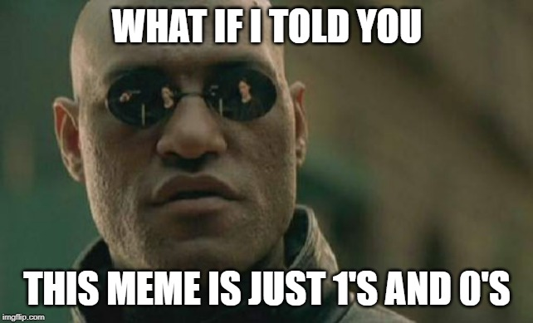
The problem of dealing with binary and the need for programming languages
Observation: In a computer, and due to hardware reasons, all operations (that is the computational and memory tasks) and are performed in binary.
Problem: Binary is heavy and difficult to read for humans.
Example: “Matthieu”, in binary, is “01001101 01100001 01110100 01110100 01101000 01101001 01100101 01110101“.

Slide 30
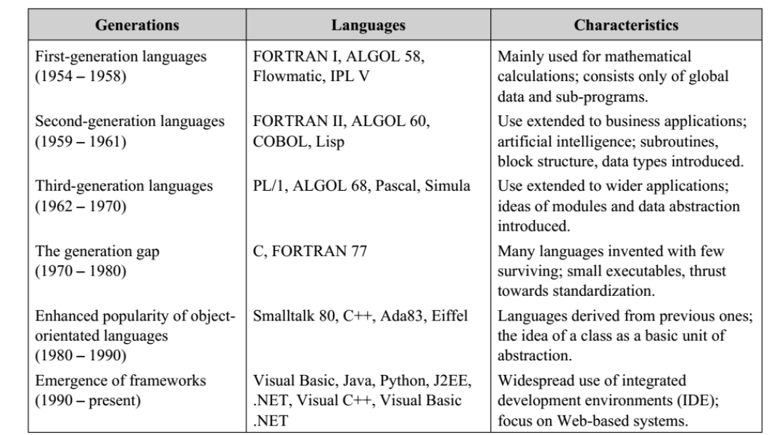
The problem of dealing with binary and the need for programming languages
Problem: How can human conveniently discuss algorithms with a computer that is designed to work only with binary?
→ Solution: find an intermediate language, readable by humans, to address the computer.
High-level language: closer to human language (easy to learn)
Low-level language: closer to binary (faster, but difficult to learn)

Slide 31
The problem of dealing with binary and the need for programming languages
Problem: How can human conveniently discuss algorithms with a computer that is designed to work only with binary?
→ Solution: find an intermediate language, readable by humans, to address the computer.
High-level language: closer to human language (easy to learn)
Low-level language: closer to binary (faster, but difficult to learn)

Slide 32

What is the Python programming language?
Definition (Python): Python is an interpreted, high-level, general-purpose programming language.
Created by Guido van Rossum and first released in 1991.
Currently v3, since 2008 (v4 soon?!).
Python's design philosophy emphasizes code readability. Its language constructs aim to help programmers write simple and clear, logical code for their projects.

Slide 33
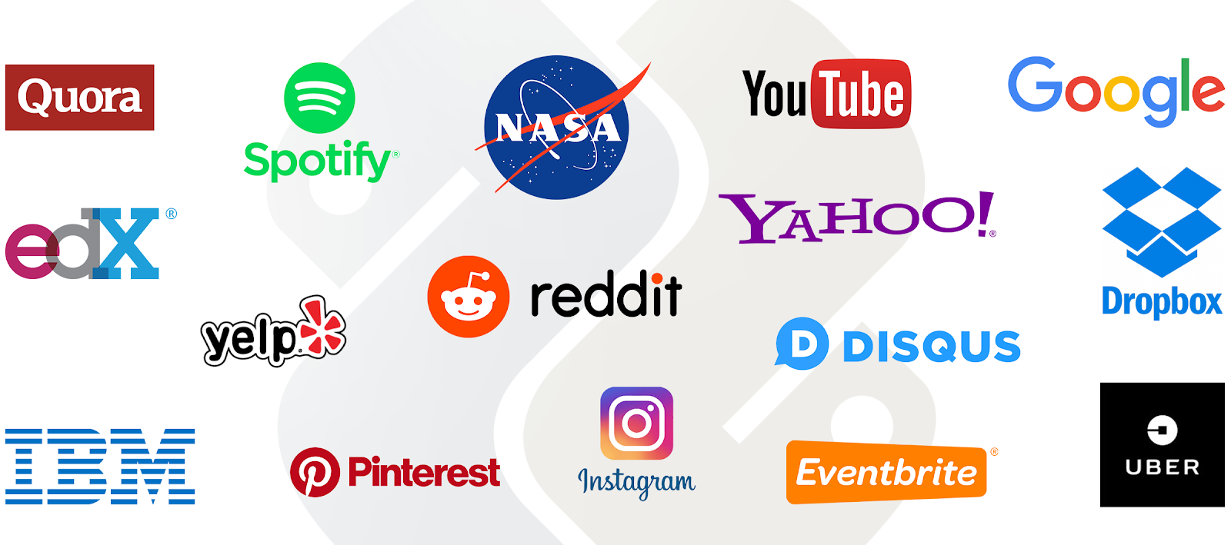
Why learn Python?
High-level language: easy to write and read, and therefore well-suited for beginners.
Wide variety of packages: can be used for multiple purposes (computer software, phone apps, video games, web, etc.)
Dynamic typing: in layman terms, Python is able to manage the data saved to memory, in an automated and efficient fashion, without human intervention.
Python is the #1 language for data science and AI at the moment: several AI frameworks such as Tensorflow (Google AI) and Pytorch (widely used in academic research on AI), etc.

Slide 34
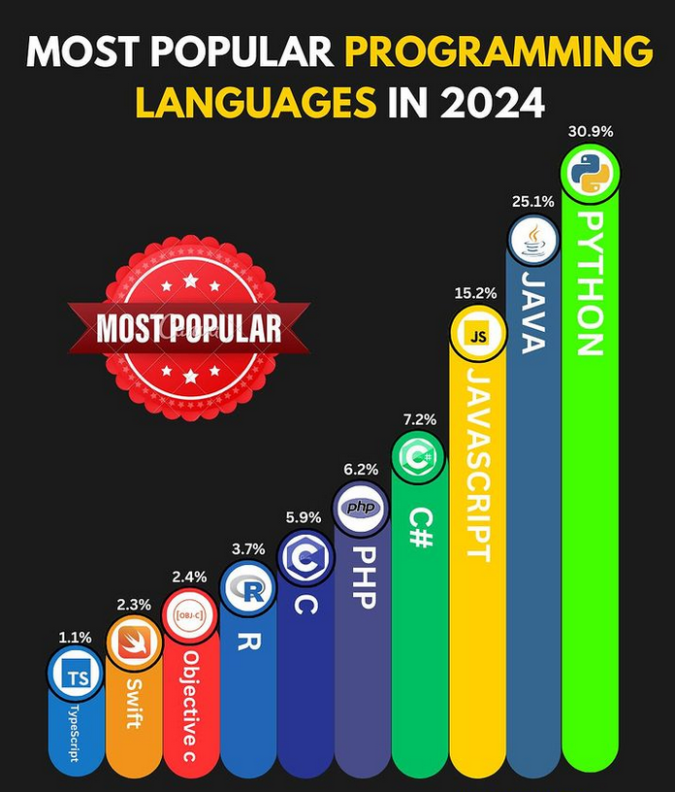
Why learn Python?
Overall, Python is a good entry point for beginners in both programming and computer science, and therefore the first language we decided to teach.
Also, high interoperability with other languages: Jumping to or including another programming language (Java, C, SQL, etc.) is easy, once you know Python.

Slide 35
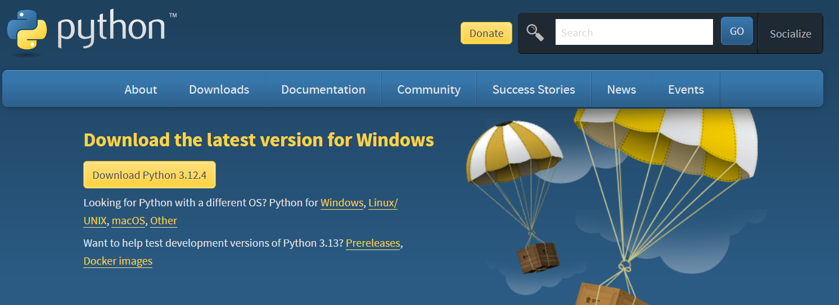
Installing Python
Install it now!
In this class, we will use Python 3.13.7 (latest stable version available as of the 10th of Aug 2025).
Download it here (for 32/64-bit Windows and Mac users, Linux users can get it via apt-get): https://www.python.org/downloads/

Slide 36
Installing Python
Important note: Check your installed programs for existing versions of Python already installed on your machines. Not a good idea to install multiple v3 versions of Python on the same machine!
Exception for (old) MacOS users: Python v2 might be installed as it is required for some components of MacOS. Do not uninstall it, and just install Python v3, keeping the v2 on the side as it is.

Slide 37
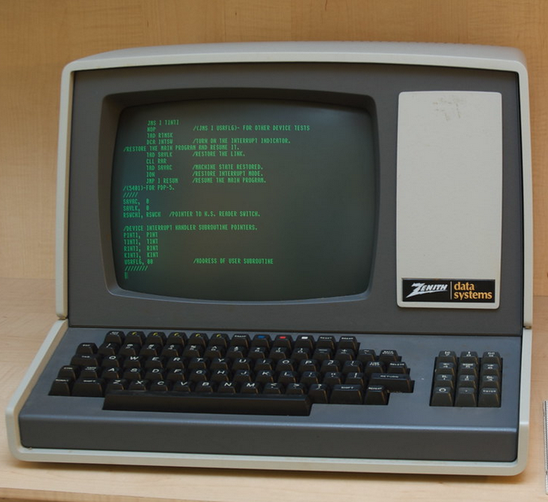
The Console/Terminal/Shell/Bash
Definition (Console, Terminal, Shell, or Bash):
The console (or terminal or shell or bash) is a text prompt expecting commands, which can be used to communicate with your computer.
(And in the early days of computers, it was the only way to communicate with them!)

Slide 38
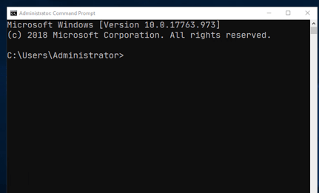
The Console/Terminal/Shell/Bash
Definition (Console, Terminal, Shell, or Bash):
The console (or terminal or shell or bash) is a text prompt expecting commands, which can be used to communicate with your computer.
Nowadays, your Operating System (OS) provides a user-friendly way to communicate with your computer and “hides” the need for a console.
But consoles are still there, hidden somewhere in your computers anyway!

Slide 39
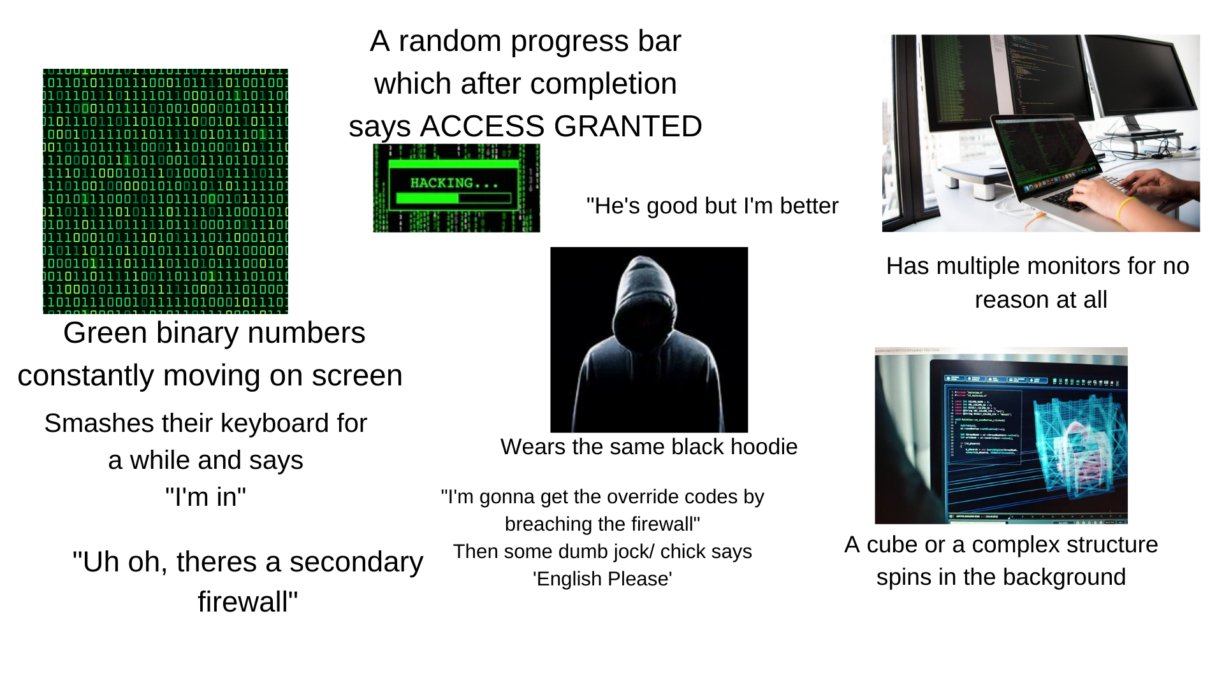
The Console/Terminal/Shell/Bash
Definition (Console, Terminal, Shell, or Bash):
The console (or terminal or shell or bash) is a text prompt expecting commands, which can be used to communicate with your computer.
Nowadays, your Operating System (OS) provides a user-friendly way to communicate with your computer and “hides” the need for a console.
(Typically, you see consoles all the time in computer/hacker movies.)
Hacker in movies starter pack

Slide 40
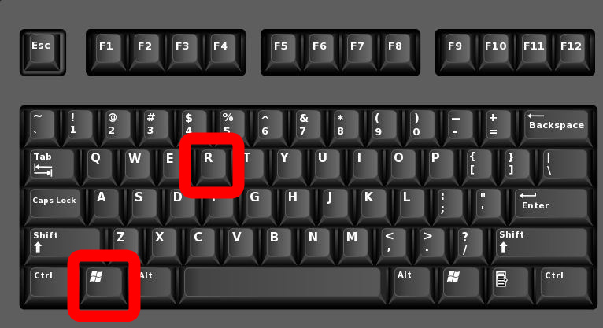
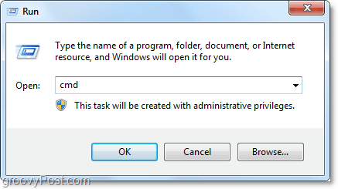
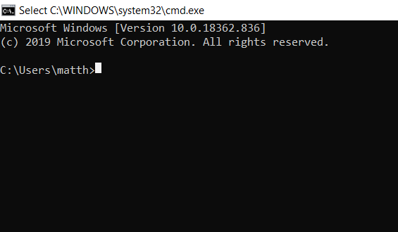
Opening a console (Windows)
Check your installation has completed appropriately, by trying to open a console.
Windows: the simple way.
Press simultaneously Windows key + R,
then type cmd (which is short for command console), and press Enter.

Slide 41
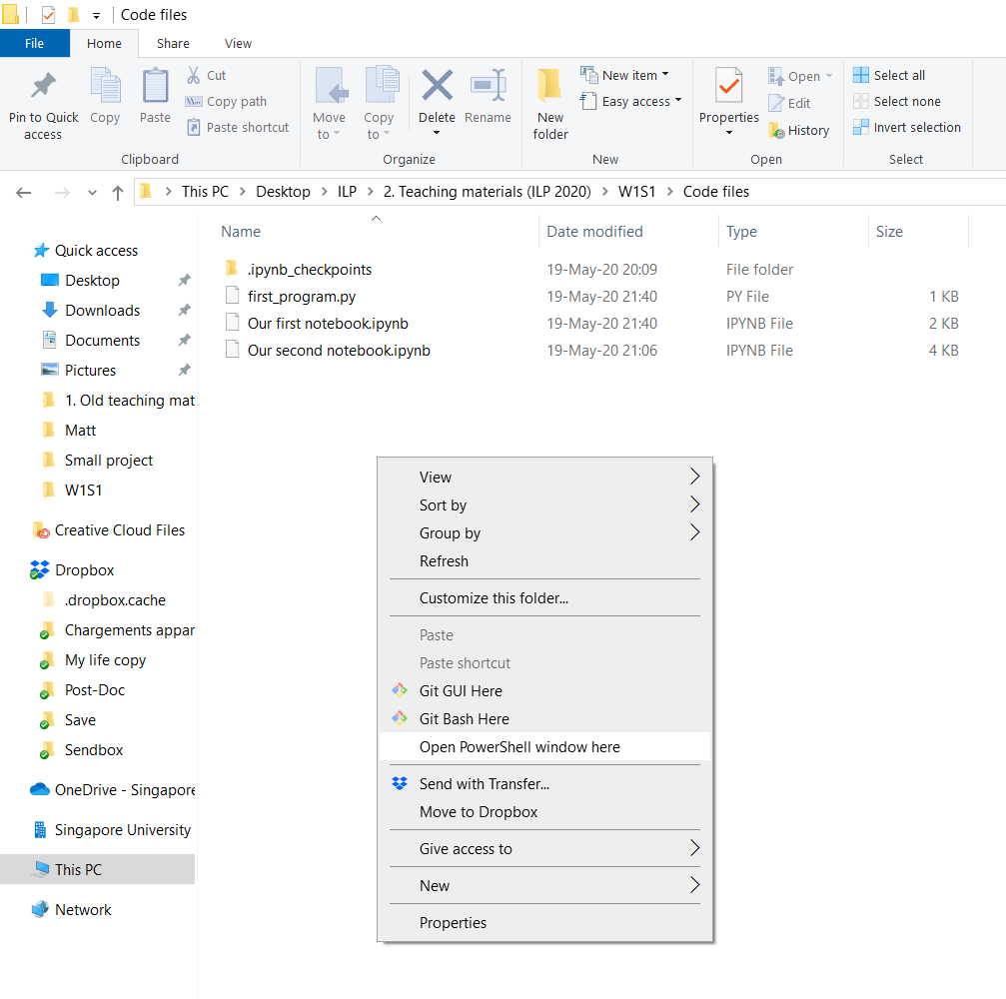
Opening a console (Windows – option 2)
Windows option 2: Faster and more convenient way.
Open an explorer window/file manager window in the folder you attempt to work in.
Hold shift and right-click in an empty space of the explorer window.
Choose “Open Powershell window here”.

Slide 42
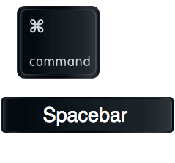
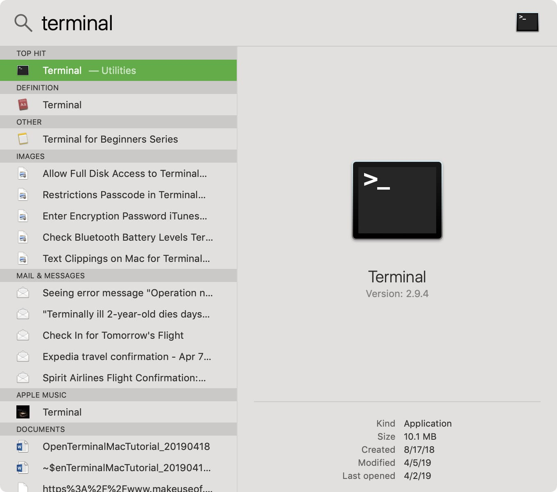
Opening a console (Mac OS)
Mac: roughly the same procedure as Windows.
Press simultaneously Command key + Space,
Then type Terminal,
It should appear as your top result, click it.

Slide 43
Opening a console (Mac OS)
Mac option 2: roughly the same procedure as Windows.
Open a Finder window and navigate to the folder you want to work in.
Right-click (or Control-click) in an empty space within the folder.
Choose "New Terminal at Folder" from the context menu.
Debug: If you do not see the "New Terminal at Folder" option:
Open the “System Preferences”. Go to "Keyboard“, then the "Shortcuts" tab.
Select “Services” from the list on the left. Look for the “Files and Folders” section.
Ensure that the checkbox next to “New Terminal at Folder” is checked.

Slide 44
Opening a console (Mac OS)
Mac option 2: roughly the same procedure as Windows.
Open a Finder window and navigate to the folder you want to work in.
Right-click (or Control-click) in an empty space within the folder.
Choose "New Terminal at Folder" from the context menu.
Mac Option 3: There is also, on recent version of MacOS, the possibility of dragging and dropping a folder onto the terminal icon to open a terminal in the location of the given folder.
This might, however, only work on recent version of MacOS.
Either way, try it out, feel free to google it to figure out something that works for you!

Slide 45
OS mode vs. Python mode
After installing Python, you may use the console to type Windows/Mac/OS commands (a.k.a. OS mode).
Typically, commands for creating, copying, pasting, moving through folders/files, etc.
You may also use a command to start a Python environment.
While in the Python environment or Python mode, your console expects Python-type commands (not OS ones!).
How do you know which mode you are in?
(We will show how it is done on Windows, but roughly similar in MacOS/Linux.)

Slide 46
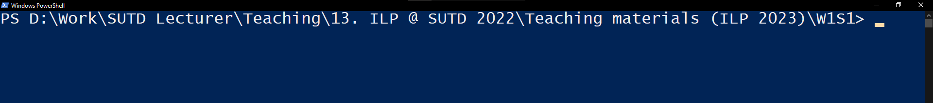
OS mode vs. Python mode
After installing Python, you may use the console to type Windows/Mac/OS commands (a.k.a. OS mode).
Typically, commands for creating, copying, pasting, moving through folders/files, etc.
You may also use a command to start a Python environment.
While in the Python environment or Python mode, your console expects Python-type commands (not OS ones!).
Line starts with current file folder description (= OS mode)

Slide 47
Some commands to use in OS mode
Out of scope, but feel free to try some of these OS commands for fun!
mkdir xyz: creates a folder with name “xyz”, at the current location of your terminal.
del xyz: deletes a folder or file with name “xyz”, at the current location of your terminal.
cd xyz: move the terminal from its current location to the subfolder with name “xyz”, assuming this subfolder is in the current location of the terminal.
Many more OS commands for you to explore: https://devblogs.microsoft.com/scripting/table-of-basic-powershell-commands/

Slide 48
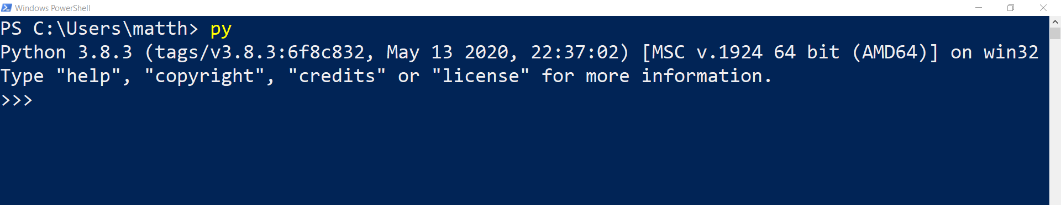
Your first run of Python!
Start Python by typing one of the following commands in the console, while in OS mode and press Enter! (Note: one of these should work, might vary depending on your machine!).
py (most frequent one, works in my case)
py3
python
python3

Slide 49
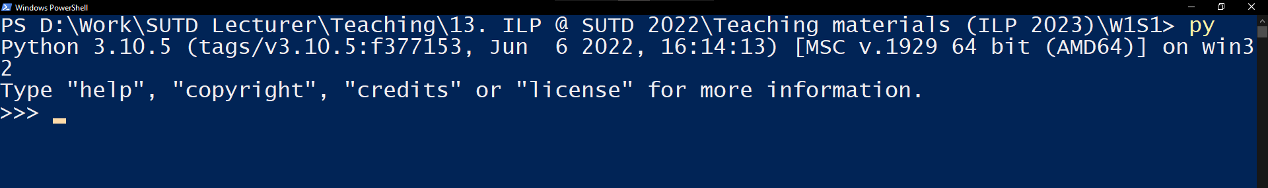
OS mode vs. Python mode
After installing Python, you may use the console to type Windows/Mac/OS commands (a.k.a. OS mode).
Typically, commands for creating, copying, pasting, moving through folders/files, etc.
You may also use a command to start a Python environment.
While in the Python environment or Python mode, your console expects Python-type commands (not OS ones!).
Line starts with three arrows (= Python mode)

Slide 50
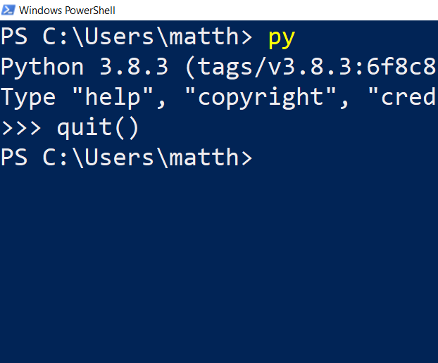
Your first run of Python!
Start Python by typing one of the following commands in the console, while in OS mode and press Enter! (Note: one of these should work, might vary depending on your machine!).
py (most frequent one, works in my case)
py3
python
python3
To exit the Python environment and go back to your OS console, simply type quit() while in Python mode and press enter.

Slide 51
Your first run of Python!
Start Python by typing one of the following commands in the console, while in OS mode and press Enter! (Note: one of these should work, might vary depending on your machine!).
py (most frequent one, works in my case)
py3
python
python3
Important note: Make sure this command started the correct version of Python (should be v3.X.something). Especially for MacOS users with a v2 and v3 installed!
If it starts v2, try another keyword until you find the right one to use!

Slide 52
Installing & updating packages in Python
Next, let us install packages. (Packages are extra functionalities for Python.)
To do so, run the command in red, below, in your console, while in the OS mode.
Note: if you are using the command py3, python or python3 instead of py, adjust accordingly!
It shall run for a while, download and install a few libraries or Python… (numpy for advanced math computation matplotlib for displays, and notebook, which we will use later on)
py –m pip install numpy notebook matplotlib

Slide 53
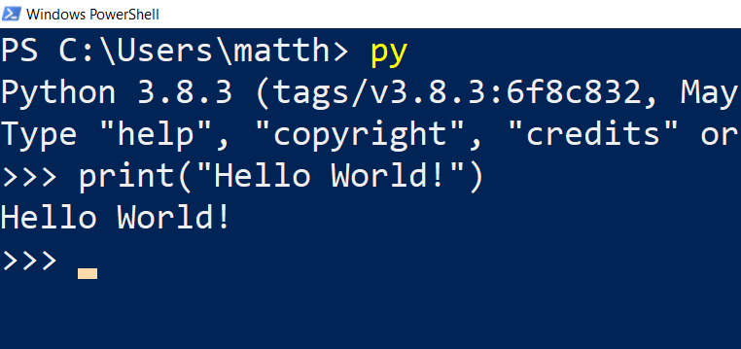
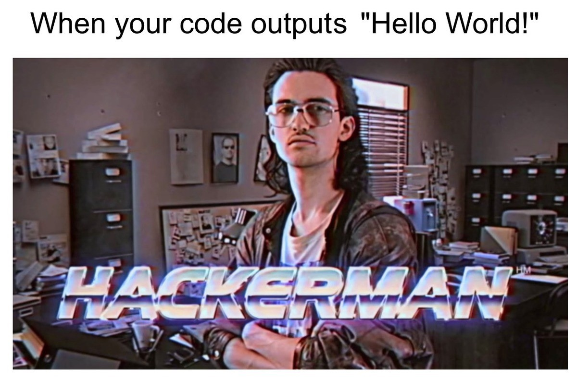
Our first program!
Definition (the “Hello World” program): The “Hello World” program is a computer program that outputs or displays the message "Hello World!". It is often used as a sanity test to make sure that a computer language is correctly installed.
Start Python in a console, type print(“Hello World!”), and submit by pressing Enter. It should display “Hello World!”.

Slide 54
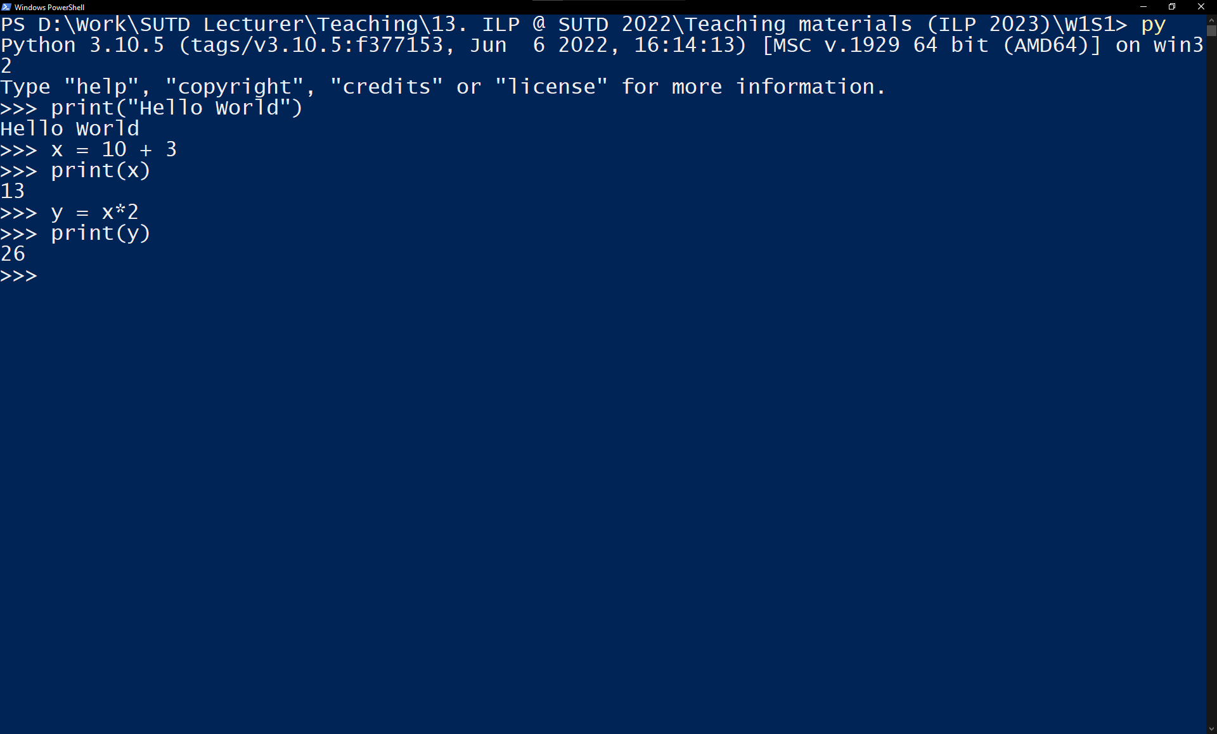
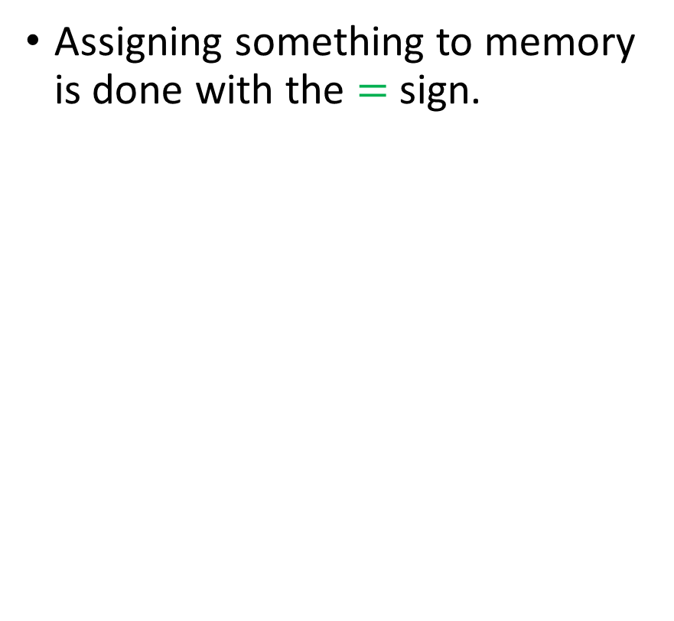
Our first program!
Assigning something to memory is done with the $=$ sign.

Slide 55
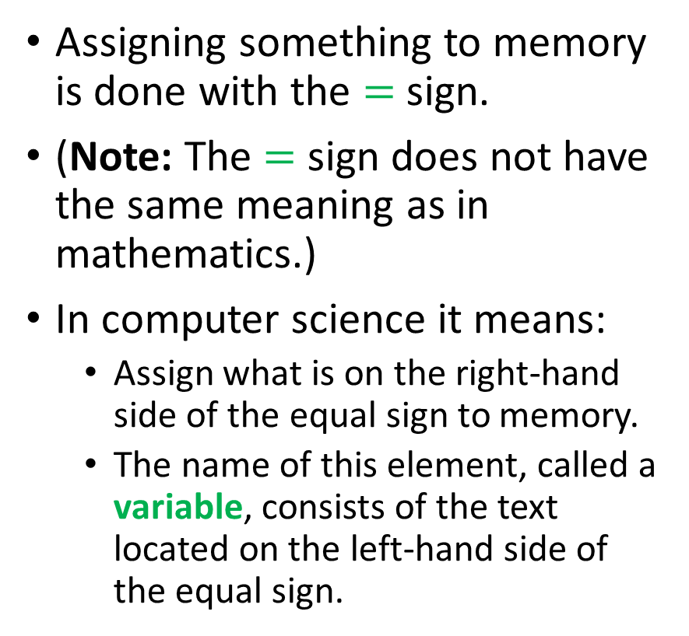
Our first program!
Assigning something to memory is done with the $=$ sign.
(Note: The $=$ sign does not have the same meaning as in mathematics.)
In computer science it means:
Assign what is on the right-hand side of the equal sign to memory.
The name of this element, called a variable, consists of the text located on the left-hand side of the equal sign.

Slide 56
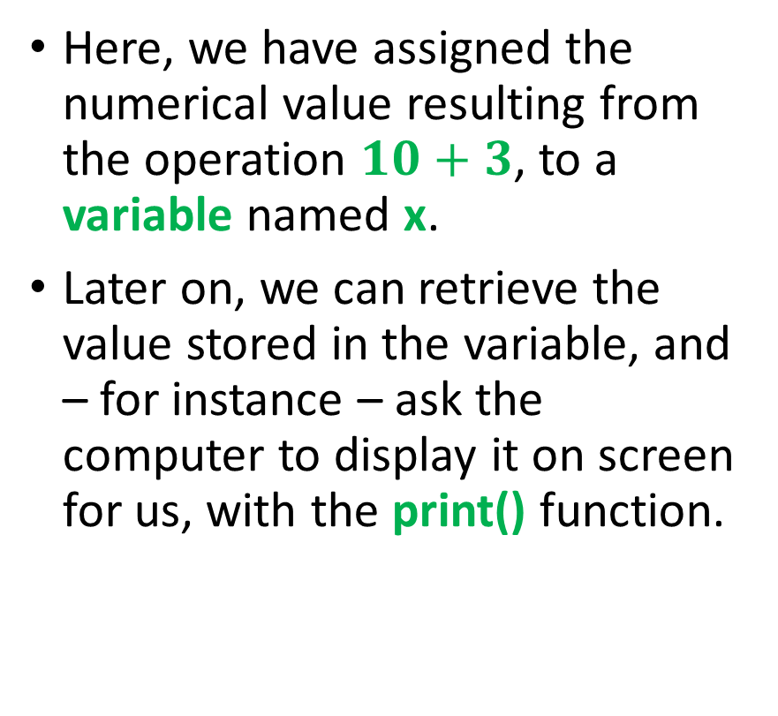
Our first program!
Here, we have assigned the numerical value resulting from the operation $10+3$, to a variable named x.
Later on, we can retrieve the value stored in the variable, and – for instance – ask the computer to display it on screen for us, with the print() function.

Slide 57
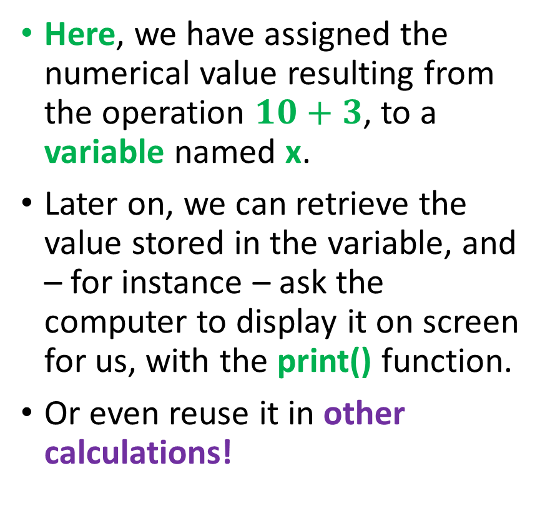
Our first program!
Here, we have assigned the numerical value resulting from the operation $10+3$, to a variable named x.
Later on, we can retrieve the value stored in the variable, and – for instance – ask the computer to display it on screen for us, with the print() function.
Or even reuse it in other calculations!

Slide 58
Our first program!
Here, we have assigned the numerical value resulting from the operation $10+3$, to a variable named x.
Later on, we can retrieve the value stored in the variable, and – for instance – ask the computer to display it on screen for us, with the print() function.
Or even reuse it in other calculations!
Important: these commands executed in the background but showed nothing in the console!
Need to explicitly ask for a print()!

Slide 59
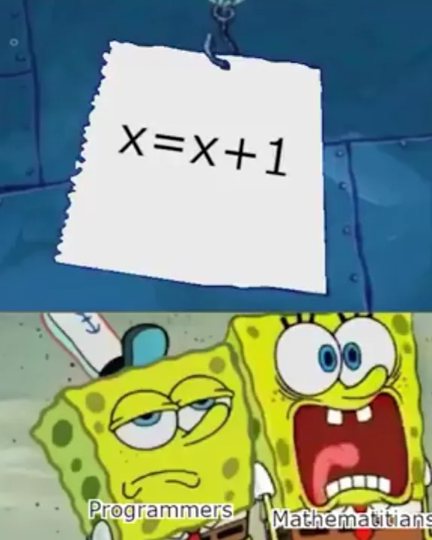
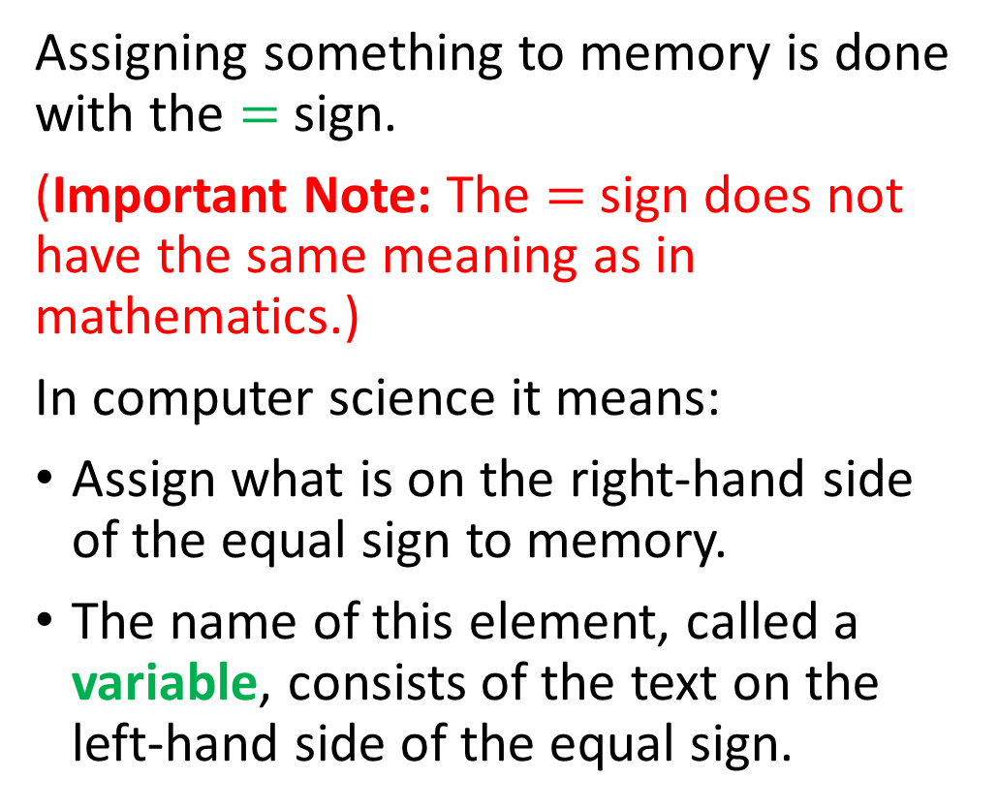
Our first program!
Assigning something to memory is done with the $=$ sign.
(Important Note: The $=$ sign does not have the same meaning as in mathematics.)
In computer science it means:
Assign what is on the right-hand side of the equal sign to memory.
The name of this element, called a variable, consists of the text on the left-hand side of the equal sign.
An important note on the use of the equal sign in computer science.

Slide 60

Matt’s Great advice (First of many)
Matt’s Great Advice: the print() function in Python.
The print() function is the most important Python function.
It is only way for you to check what is being computed and stored in memory at any given time.
Use it and abuse it, to check what your program is doing!

Slide 61
Executing a .py file in console mode
You should have downloaded a few files along with the lecture notes/slides we are currently using.
More specifically, we will now use the first_program.py file, located in the “Code files” folder.
Identify where you downloaded and stored your first_program.py file. We need to know where it is currently located, before moving to the next slide.

Slide 62
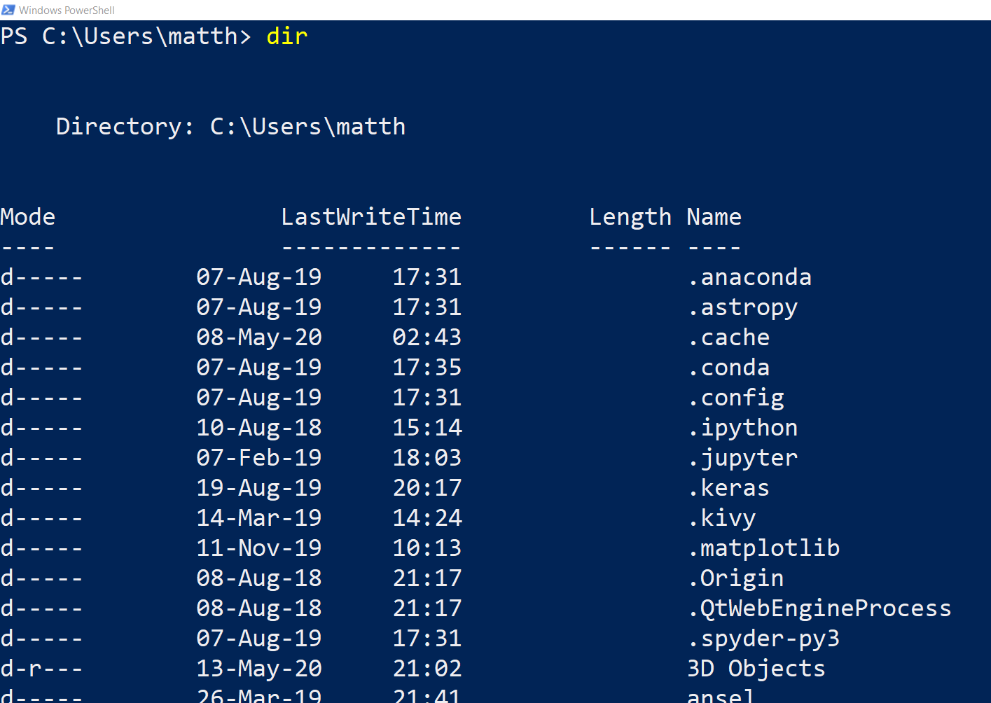
Executing a .py file in console mode
Current location is C:\Users\matth\
Command (dir/ls): The dir command (or ls command in Mac OS/Linux) lists the folders and files in your current location.

Slide 63
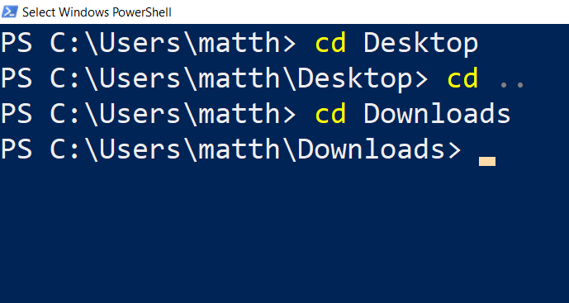
Executing a .py file in console mode
Command (dir/ls): The dir command (or ls command in Mac OS/Linux) lists the folders and files in your current location.
Command (cd): The cd command changes your current location to another folder, reachable from your current location in dir/ls.
Note: the command “cd ..” moves you back one level.
Observe how the current location is changing every time.

Slide 64
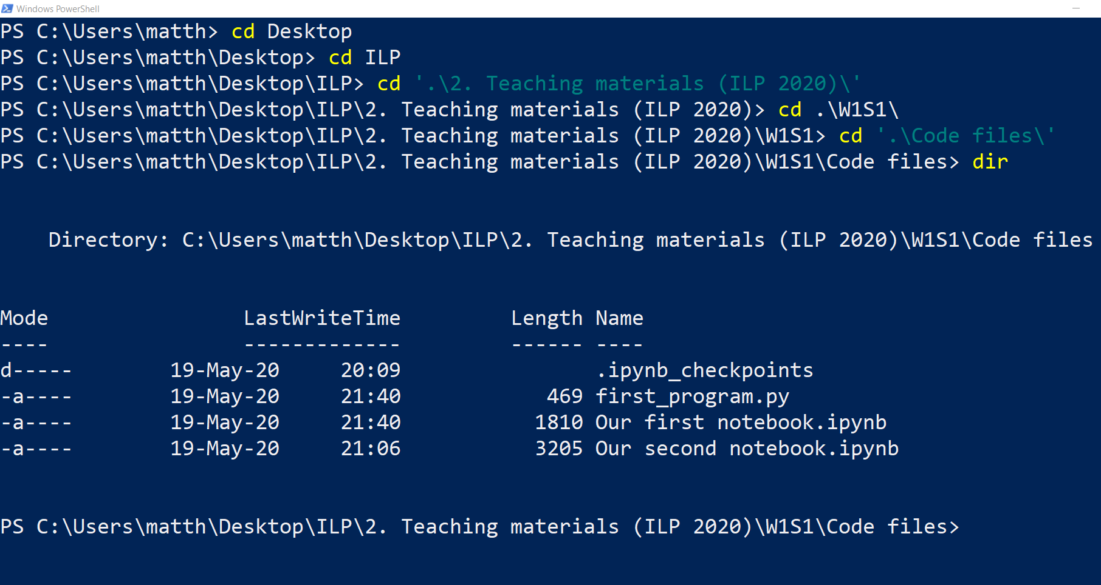
→ Now, use cd/dir/ls commands to move to the location of your first_program.py file !

Slide 65
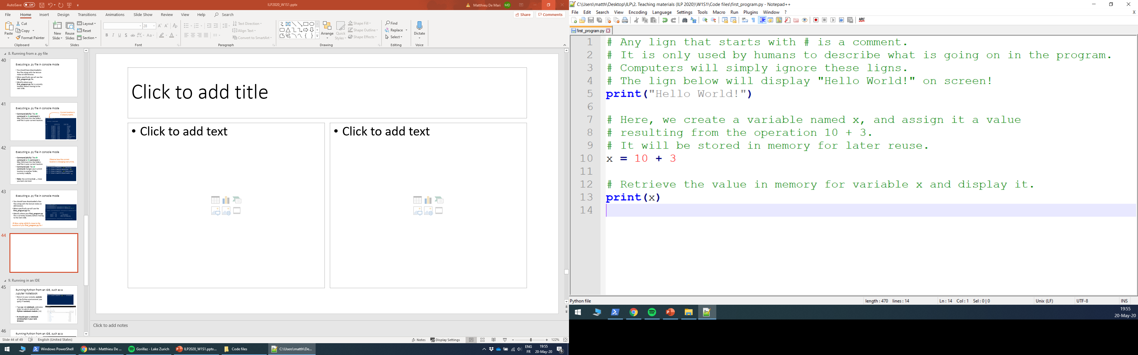
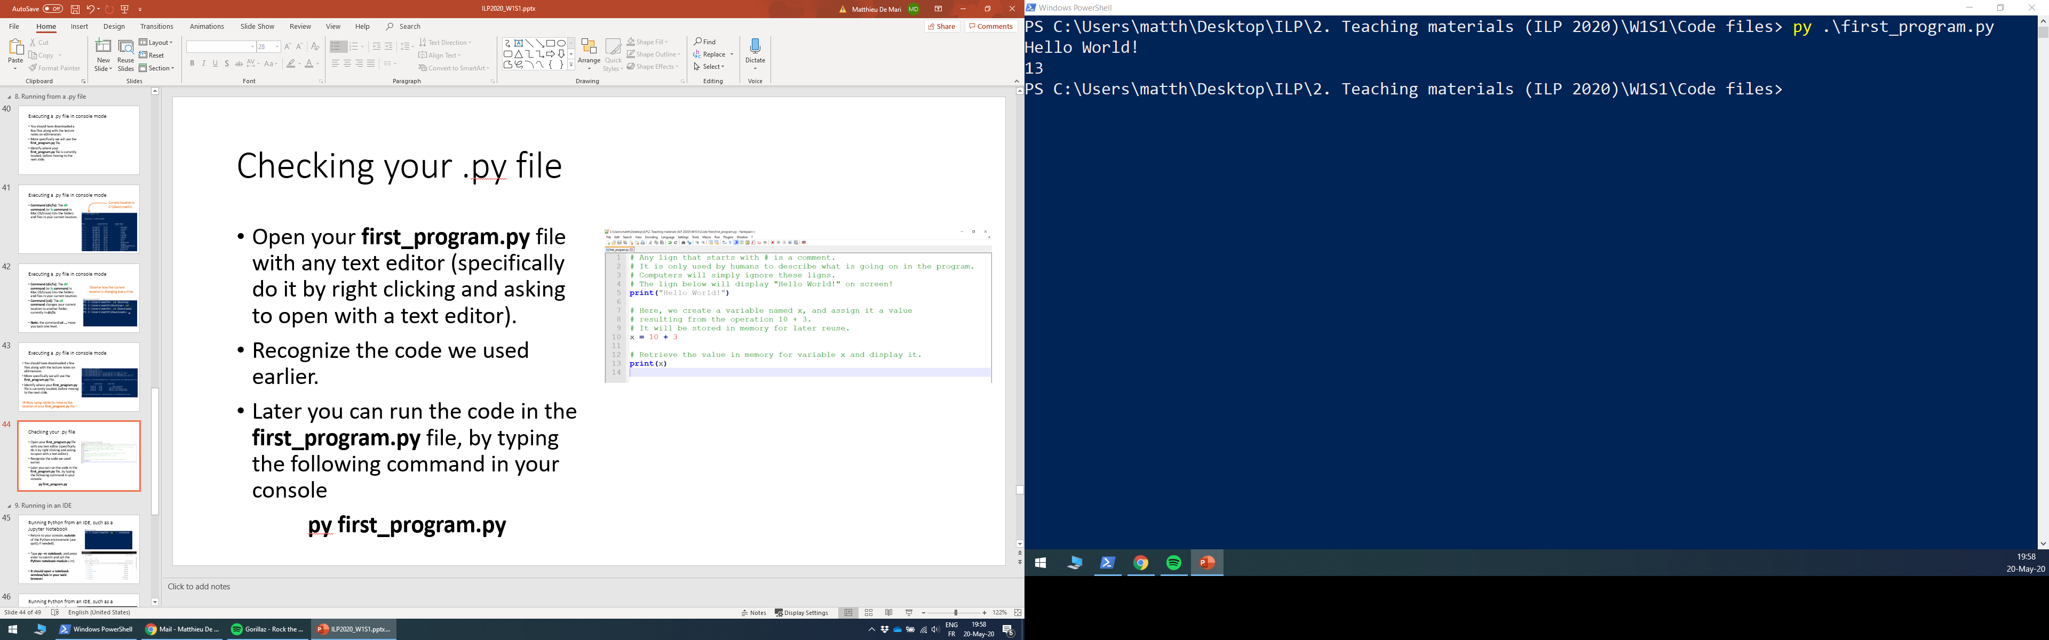
Checking your .py file
Open your first_program.py file with any text editor (specifically do it by right clicking and asking to open with a text editor such as Notepad or Notepad++).
You should recognize the code we used earlier.
Later on, you can run the code in the first_program.py file, all at once, by typing the following command in your console
py first_program.py

Slide 66
Running Python from an IDE
Problem: Typing code in a text editor and running it from console is not exactly convenient… In fact, it requires to alt-tab a lot!
→ Suggestion: we should use an Interactive Development Environment (IDE), which makes the coding easier for us.
→ In this course, I suggest to use Jupyter Notebook and/or Jupyter Lab environments, but you might look online for other IDEs and learn about them if you want!

Slide 67
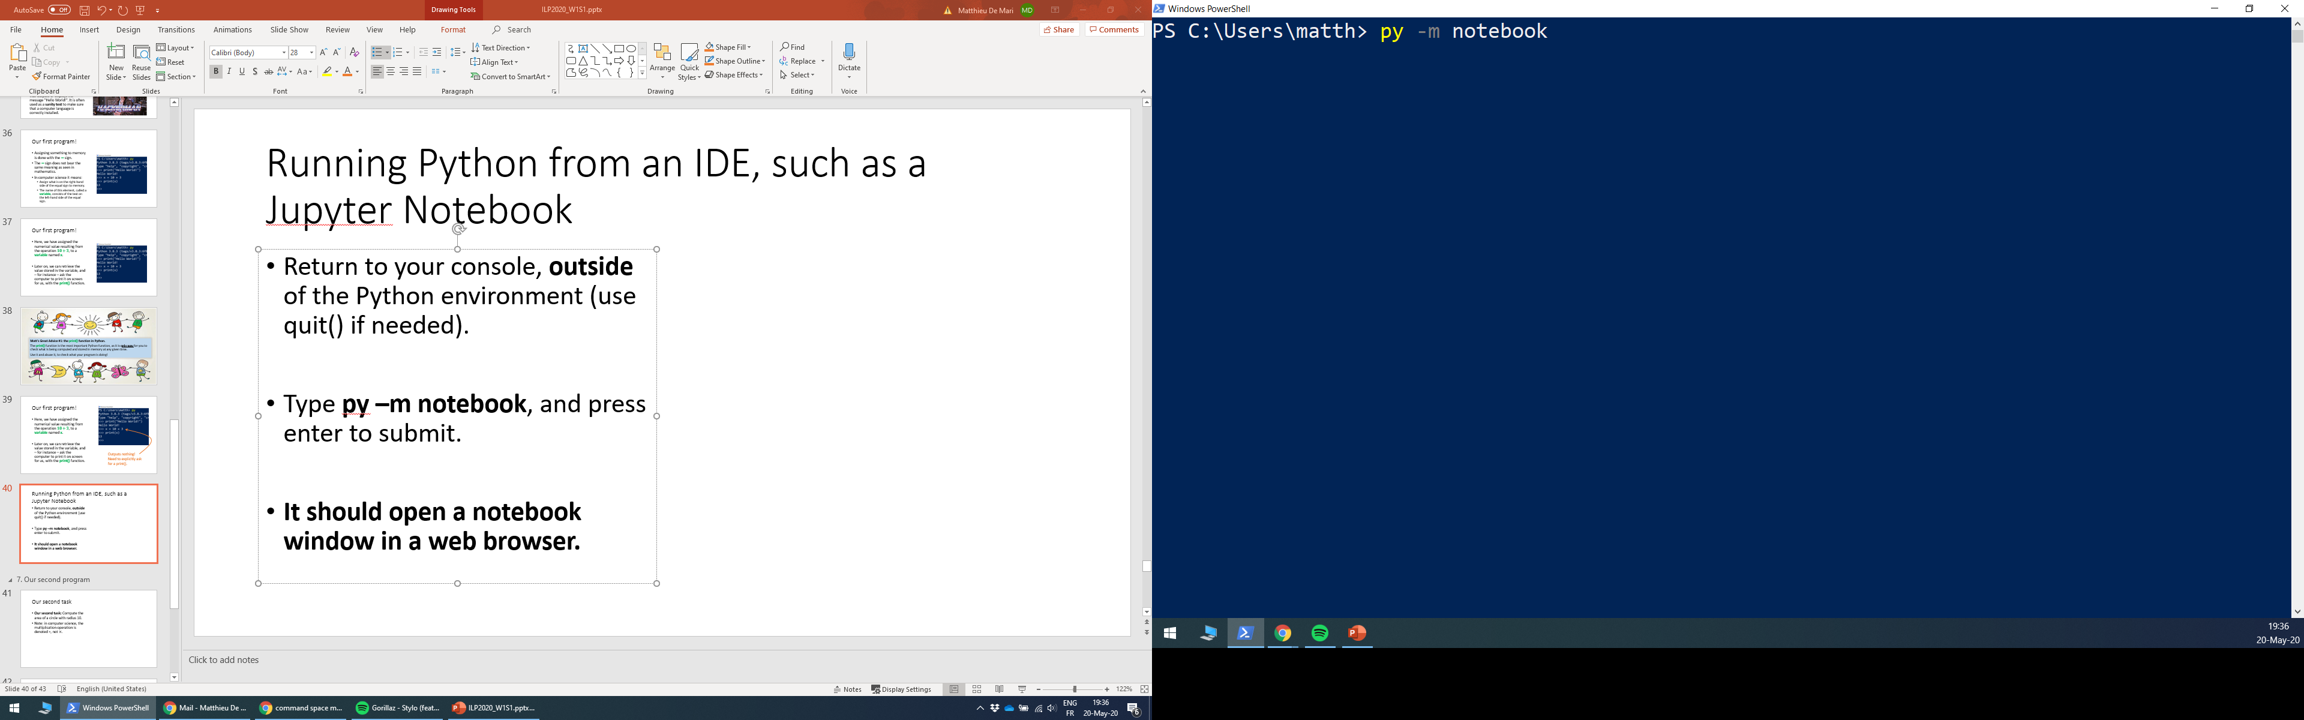

Running Python from an IDE, such as a Jupyter Notebook
Return to your console, in OS mode (use quit() while in Python mode to return to OS mode if needed).
Type py –m notebook, and press enter to submit and call the Python notebook module.
It should open a notebook window/tab in your web browser.

Slide 68

Running Python from an IDE, such as a Jupyter Notebook
Notebooks are a more convenient way to navigate your files (rather than using cd repeatedly) and to program using Python.
Move to the folder where the code you downloaded for today’s lecture is.
Let us try opening “Our first notebook.ipynb” by clicking it.
(Files ending in .ipynb are Jupyter Notebooks)

Slide 69

Running Python from an IDE, such as a Jupyter Notebook
Notebooks provide a mixed combination of
text blocks (in Markdown text language, ignore that)
and code blocks (in Python, these blocks have a “In […]” on their left side).
Try executing a cell of code by selecting it and pressing Shift+Enter!
A lot more convenient, isn’t it?

Slide 70


Our second task
Now that we know how to run Python in a Notebook environment, let us consider a second task…
We will ask the computer to compute the area of a circle with radius 10.
Open the second notebook.
Note: in computer science, the multiplication operation is denoted $∗$, not $×$.

Slide 71

A problem with our second task…
Problem: While the task seems easy mathematically speaking, we have a problem… We need the value of the constant pi.
Python does not know it by default like your calculator…
We could create a variable named pi and assign it the value 3.14, but it is better (and more accurate) to retrieve it from a package.

Slide 72



Importing from a Python package
By default, Python is a simple yet powerful calculator, which can only perform basic calculations (additions, multiplications, etc.)
If we need more advanced concepts, we need to import them from a package.
Importing $≈$ adding a specific button to your calculator so it can run more advanced operations!

Slide 73

Importing from a Python package
By default, Python is a simple yet powerful calculator, which can only perform basic calculations (additions, multiplications, etc.)
If we need more advanced concepts, we need to import them from a package.
Importing $≈$ adding a specific button to your calculator so it can run more advanced operations!

Slide 74

By the way, this means that you do not need your calculator anymore, maybe time to give it away.

Slide 75
Congratulations, you now have a Python-compatible machine, ready to run!
Feel free to play around a bit more if you want!

Slide 76
Conclusion (Chapter 1)
What is programming?
What are the key concepts about programming and computer science?
What is a programming language?
How do I install and configure Python?
How to I write my first programs in Python?
What is a programming environment?

Slide 77
Debugging time
If you were able to execute the two codes (in the Jupyter Notebooks): you are officially done for today.
→ Let me know ASAP if you have encountered technical issues and we will try to fix them together.

